Slide 1

HHS Family Health History Project
Data Sets and Code Values
Oct 20, 2008

Slide 2
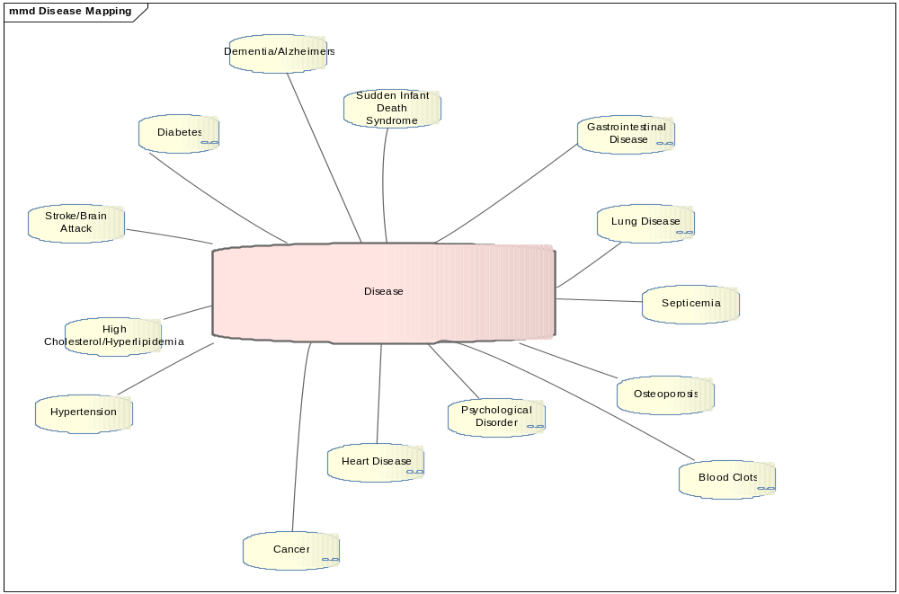
Base Disease Set

Slide 3
SNOMED Codes for Diseases
Disease Types | Coding Standard | Code Value | Notes
Stroke/Brain Attack | SNOMED | 116288000 | Paralytic stroke (disorder)
Heart Disease | SNOMED | 56265001 | heart disease - synonym of Heart disease (disorder)
Cancer | SNOMED | 363346000 | malignant neoplastic disease - synonym of Malignant neoplastic disease (disorder)
Hypertension | SNOMED | 38341003 | Hypertensive disorder, systemic arterial (disorder)
High Cholesterol/Hyperlipidemia | SNOMED | 55822004 | Hyperlipidemia (disorder)
Osteoporosis | SNOMED | 64859006 | Osteoporosis (disorder)
Kidney Disease | SNOMED | 90708001 | kidney disease - synonym of Kidney disease (disorder)
Diabetes | SNOMED | 73211009 | diabetes mellitus - synonym of Diabetes mellitus (disorder)
Sudden Infant Death Syndrome | SNOMED | 160957000 | sudden infant death - synonym of Sudden infant death (event)
Lung Disease | SNOMED | 19829001 | synonym of Disorder of Lung (disorder)
Gastrointestinal Disease | SNOMED | 119292006 | synonym of Disorder of gastrointestinal tract (disorder)
Blood Clots | SNOMED | 4779008 | synonym of Blood coagulation disorder (disorder)
alzheimersDementia | SNOMED | 192160005 | synonym of Dementia in Alzheimers (disorder)
Psychological Disorders | SNOMED | UNKNOWN | UNKNOWN

Slide 4
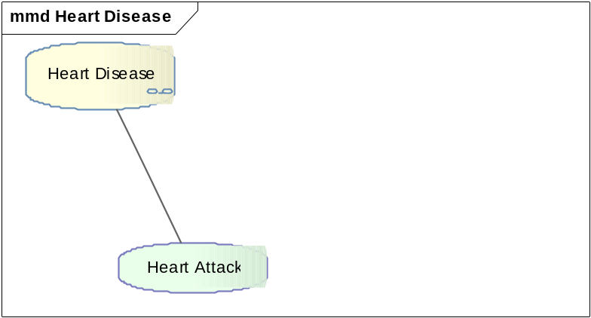
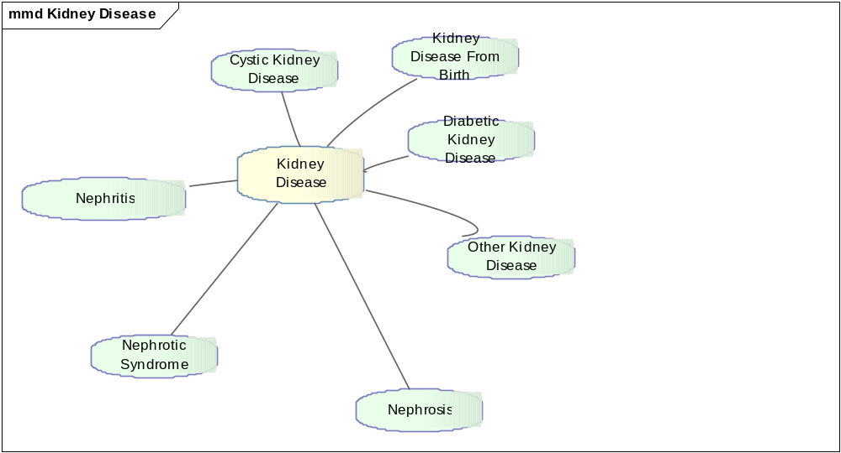
Heart and Kidney Disease Subsets

Slide 5
SNOMED Codes for Kidney Disease
Types of Kidney Diseases | Coding Standard | Code Value | Notes
Cystic Kidney Disease | SNOMED | 236439005 | cystic disease of kidney - synonym of Cystic disease of kidney (disorder)
nephrosis | SNOMED | 90708001 | nephrosis - synonym of Kidney disease (disorder)
nephritis | SNOMED | 52845002 | nephritis - synonym of Nephritis (disorder)
nephrotic syndrome | SNOMED | 52254009 | nephrotic syndrome - synonym of Nephrotic syndrome (disorder
Kidney Disease Present From Birth | SNOMED | 82525005 | synonym of Congenital cystic kidney disease (disorder)
Diabetic Kidney Disease | SNOMED | 127013003 | diabetic renal disease - synonym of Diabetic renal disease (disorder)
Other/Unknown | SNOMED | 90708001 | Will use the parent value
SNOMED Codes for Heart Disease
Types of Heart Diseases | Coding Standard | Code Value | Notes
Heart Attack | SNOMED | 22298006 | Myocardial infarction (disorder)

Slide 6
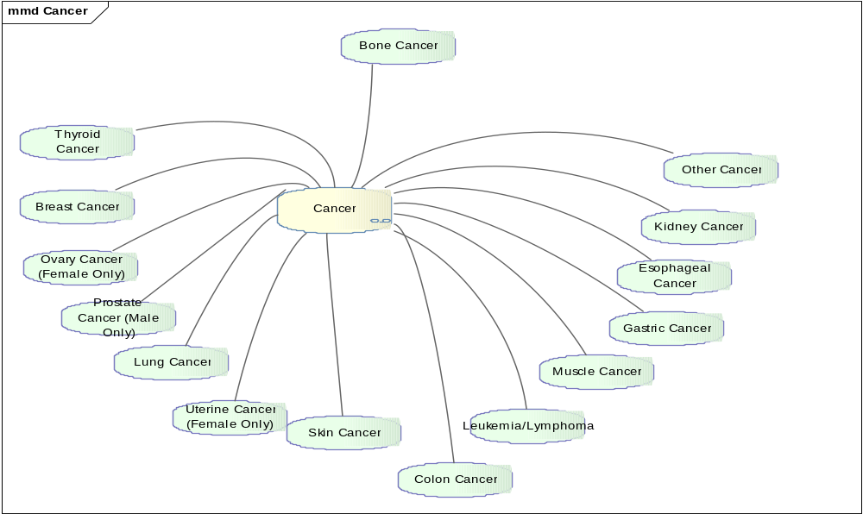
Cancer Disease Subset

Slide 7
SNOMED Codes for Cancers
Types of Cancer | Coding Standard | Code Value | Notes
Breast Cancer | SNOMED | 254837009 | Malignant tumor of breast (disorder)
Colon Cancer | SNOMED | 363406005 | Malignant tumor of colon (disorder)
Prostate Cancer | SNOMED | 399068003 | Malignant tumor of prostate (disorder)
Ovarian Cancer | SNOMED | 363443007 | Malignant tumor of ovary (disorder)
Thyroid Cancer | SNOMED | 363478007 | Malignant tumor of thyroid gland (disorder)
Kidney Cancer | SNOMED | 363518003 | Malignant tumor of kidney (disorder)
Lung Cancer | SNOMED | 363358000 | Malignant tumor of lung (disorder)
Skin Cancer | SNOMED | 372130007 | synonym of Malignant neoplasm of skin (disorder)
Uterine Cancer | SNOMED | 371973000 | synonym of Malignant neoplasm of uterus (disorder)
Leukemia/Lymphona | SNOMED | 110007008 | adult t-cell leukemia/lymphoma - synonym of adult t-cell leukemia/lymphoma (disorder)
Muscle Cancer | SNOMED | 363495004 | cancer of muscle - synonym of Malignant tumor of muscle (disorder)
Gastric Cancer | SNOMED | 363349007 | gastric cancer - synonym of Malignant tumor of stomach (disorder)
Esophageal Cancer | SNOMED | 363402007 | esophageal cancer - synonym of Malignant tumor of esophagus (disorder)
Bone Cancer | SNOMED | 269466003 | bone cancer - synonym of Malignant tumor of bone and articular cartilage (disorder)
Other Cancer | SNOMED | 363346000 | using code for cancer synonym Malignant neoplastic disease)

Slide 8
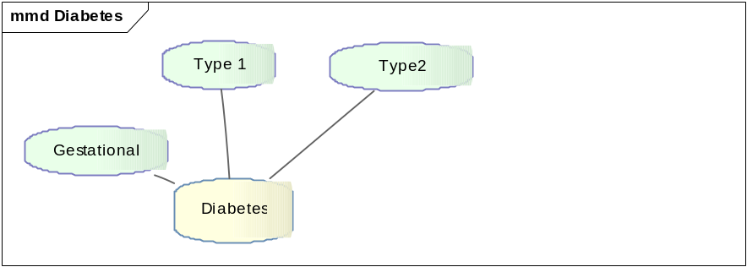
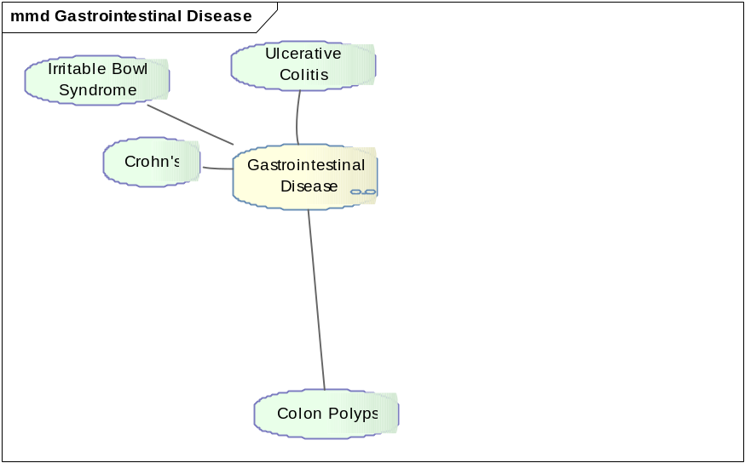
Diabetes and GI Disease Subset

Slide 9
SNOMED Codes for Diabetes
Types of Diabetes | Coding Standard | Code Value | Notes
Diabetes Type 1 | SNOMED | 46635009 | Diabetes mellitus type 1 (disorder)
Diabetes Type 2 | SNOMED | 44054006 | Diabetes mellitus type 2 (disorder)
Gestational Diabetes | SNOMED | 11687002 | gestational diabetes - synonym of Gestational diabetes mellitus (disorder)
SNOMED Codes for GI Diseases
Types of GastroIntestinal Diseases | Coding Standard | Code Value | Notes
Crohn's Disease | SNOMED | 34000006 | crohn's disease - synonym of Crohn's disease (disorder)
Irritable Bowel Syndrome | SNOMED | 10743008 | irritable bowel syndrome - synonym of Irritable colon (disorder)
Ulceritive Colitis | SNOMED | 64766004 | ulcerative colitis - synonym of Ulcerative colitis (disorder)
Colon Polyps | SNOMED | 68496003 | polyp of colon - synonym of Polyp of colon (disorder)

Slide 10
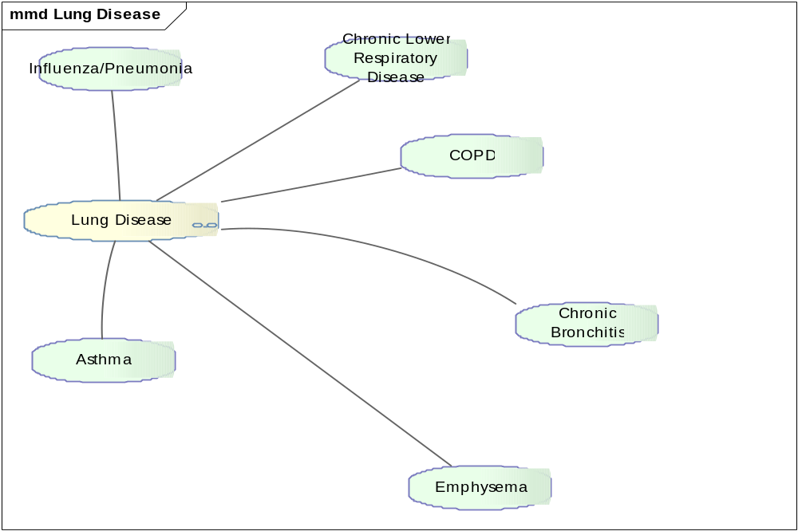
Lung Disease Subset

Slide 11
SNOMED Codes for Lung Diseases
Types of Lung Diseases | Coding Standard | Code Value | Notes
COPD | SNOMED | 13645005 | copd - synonym of Chronic obstructive lung disease (disorder)
Chronic Bronchitis | SNOMED | 63480004 | chronic bronchitis - synonym of Chronic bronchitis (disorder)
Emphysema | SNOMED | 87433001 | emphysema of lung - synonym of Pulmonary emphysema (disorder)
Chronic Lower Respiratory Disease | SNOMED | 196229000 | chronic lower respiratory diseases - synonym of Chronic lower respiratory diseases (disorder)
Influenza/Pneumonia | SNOMED | 195878008 | pneumonia and influenza - synonym of Pneumonia and influenza (disorder)
Asthma | SNOMED | 195967001 | asthma - synonym of Asthma (disorder)

Slide 12
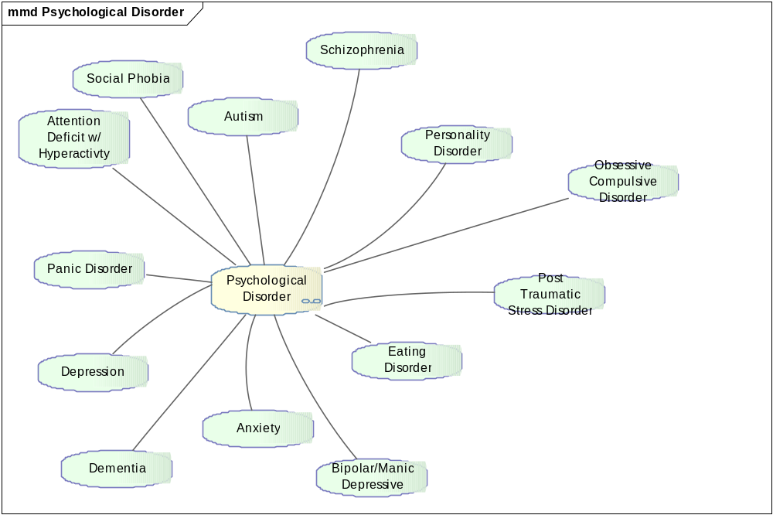
Psychological Disorder Subset

Slide 13
SNOMED Codes for Psychological Disorders
Types of Psychological Disorders | Coding Standard | Code Value | Notes
Anxiety | SNOMED | 197480006 | synonym of Anxiety disorder (disorder)
Bipolar/Manic Depressive Disorder | SNOMED | 13746004 | Bipolar disorder (disorder)
Depression | SNOMED | 35489007 | Depressive disorder (disorder)
Attention Deficit Hyper Activity | SNOMED | 406506008 | synonym of Attention deficit hyperactivity disorder (disorder)
Autism | SNOMED | 408856003 | synonym of Autistic disorder (disorder)
Personality Disorder | SNOMED | 33449004 | synonym of Personality disorder (disorder)
Eating Disorder | SNOMED | 72366004 | synonym of Eating disorder (disorder)
Obsessive Compulsive Disorder | SNOMED | 191736004 | obsessive compulsive disorder
Panic Disorder | SNOMED | 371631005 | synonym of Panic disorder (disorder)
Post Traumatic Stress Disorder | SNOMED | 47505003 | synonym of Posttraumatic stress disorder (disorder)
Schizophrenia | SNOMED | 58214004 | synonym of Schizophrenia (disorder)
Social Phobia | SNOMED | 25501002 | synonym of Social phobia (disorder)

Slide 14
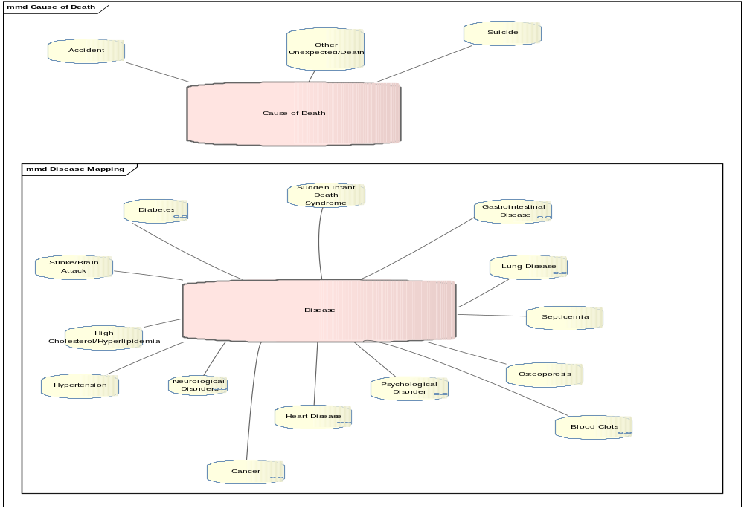
Cause of Death Set

Slide 15
SNOMED Codes for Cause of Death
Causes of Death | Coding Standard | Init | Notes
Suicide | SNOMED | 44301001 | synonym of suicide (event)
Accidental Death | SNOMED | 7878000 | synonym of Accidental Death (event)
Other/Unexpected | SNOMED | 26636000 | Sudden death (event)

Slide 16
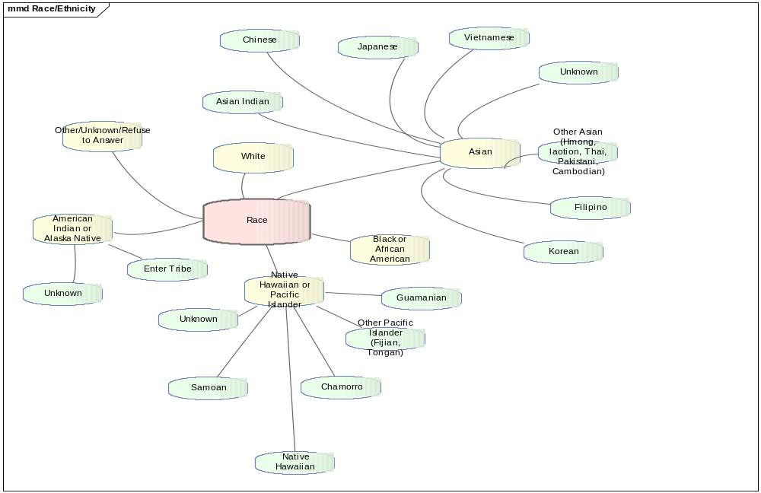
Race Set

Slide 17
HL7 Codes for Race
Race | Label | Coding Standard | Code Value | Notes
americanIndianOrAlaskaNative | American Indian or Alaska Native | HL7 | 1002-5 | American Indian or Alaska native (racial group)
asian | Asian | HL7 | 2028-9 | Asian race (racial group)
blackOrAfricanAmerican | Black OrAfricanAmerican | HL7 | 2054-5 | Black - ethnic group (ethnic group)
nativeHawaiianOrOtherPacificIslander | Native Hawaiian Or Other Pacific Islander | HL7 | 2076-8 | Hawaiians (ethnic group)
white | White | HL7 | 2106-3 | White - ethnic group (ethnic group)
other-unknown-refuseToAnswer | other-unknown-refuseToAnswer | HL7 | asked but unknown

Slide 18
HL7 Codes for Asian Sub-group
Asian Sub-groups | Label | Coding Standard | Code Value | Notes
asianIndian | Asian Indian | HL7 | 2029-7
chinese | Chinese | HL7 | 2034-7
filipino | Filipino | HL7 | 2036-2
japanese | Japanese | HL7 | 2039-6
korean | Korean | HL7 | 2040-4
otherAsian | Other Asian | HL7 | Other
Unknown | Unknown | HL7 | 2028-9 | Will pass the value for Asian
vietnamese | Vietnamese | HL7 | 2047-9

Slide 19
HL7 Codes for Native Hawaiian Sub-group
Pacific Islander Sub-groupings | Label | Coding Standard | Coding Type | Notes
chamorro | Chamorro | HL7 | 2088-3
guamanian | Guamanian | HL7 | 2087-5
nativeHawaiian | Native Hawaiian | HL7 | 2079-2
otherPacificIslander | Other Pacific Islander | HL7 | Other
samoan | Samoan | HL7 | 2080-0
unknown | Unknown | HL7 | 2076-8 | Will pass the value for the parent

Slide 20
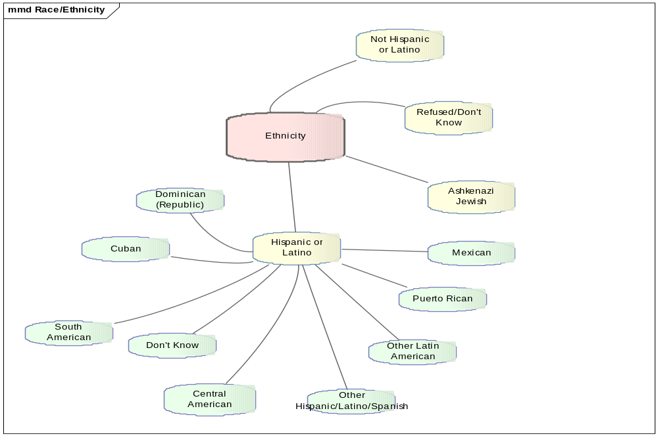
Ethnicity Set

Slide 21
HL7 Codes for Ethnicity
Ethnicity | Label | Coding Standard | Code Value | Notes
hispanicOrLatino | Hispanic or Latino | HL7 | 2135-2
notHispanicOrLatino | Non-Hispanic or Latino | HL7 | 2186-5
ashkenaziJewish | Ashkenazi Jewish | SNOMED | 81706006 | Ashkenazi Jew, follower of religion (person)

Slide 22
HL7 Codes for Hispanic Subgroup
Hispanic/Latino Sub-groupings | Label | Coding Standard | Coding Value | Notes
centralAmerican | Central American | HL7 | 2155-0 | HL7 - 2155-0
Cuban | Cuban | HL7 | 2182-4 | HL7 - 2182-4
Dominican(Republic) | Dominican(Republic) | HL7 | 2184-0 | HL-7 - 2184-0
mexican | Mexican | HL7 | 2148-5 | HL7 - 2148-5
otherHispanic/Latino/Spanish | Other Hispanic/Latino/Spanish | HL7 | Other
otherLatinAmerican | Other Latin American | HL7 | Other
puertoRican | Puerto Rican | HL7 | 2180-8 | HL7- 2180-8
southAmerican | South American | HL7 | 2165-9 | HL7 - 2165-9
Unknown | Unknown | HL7 | 2135-2 | Will send parent value

Slide 23
LOINC Codes for Age
Age | Label | Coding Standard | Code Value | Notes
inInfancy | Infancy | LOINC | 29 days to 2 years
inChildhood | Childhood | LOINC | 2+-9
20-29 | 20-29 | LOINC | 20-29
30-39 | 30-39 | LOINC | 30-39
40-49 | 40-49 | LOINC | 40-49
50-59 | 50-59 | LOINC | 50-59
over60 | over 60 | LOINC | over 60
unknown | Unknown | LOINC | asked but unknown
preBirth | Pre-Birth | LOINC | NEED WAY TO EXPRESS - does zero or -1 work?
newborn | Newborn | LOINC | 0-28days
inAdolescence | Adolescence | LOINC | 9-19years

Slide 24
HL7 Codes for Relationships
Relationship | Label | Coding Standard | Code | Notes
daughter | Daughter | HL7 | DAU | The player of the role is a daughter of the scoping person's son or daughter.
granddaughter | Granddaughter | HL7 | GRNDDAU | The player of the role is a daughter of the scoping person's son or daughter.
grandson | Grandson | HL7 | GRNDSON | The player of the role is a son of the scoping person's son or daughter.
half-brother | Half-brother | HL7 | HBRO | The player of the role is a male related to the scoping entity by sharing only one biological parent.
half-sister | Half-sister | HL7 | HSIS | The player of the role is a female related to the scoping entity by sharing only one biological parent.
MaternalAunt | Maternal Aunt | HL7 | MAUNT | The player of the role is a biological sister of the scoping person's biological mother.
MaternalCousin | Maternal Cousin | HL7 | MCOUSN | The player of the role is a biological relative of the scoping person descended from a common ancestor on the player's mother's side, such as a grandparent, by two or more steps in a diverging line.
MaternalGrandfather | Maternal Grandfather | HL7 | MGRFTH | The player of the role is the biological father of the scoping person's biological mother.
MaternalGrandmother | Maternal Grandmother | HL7 | MGRMTH | The player of the role is the biological mother of the scoping person's biological mother.
MaternalUncle | Maternal Uncle | HL7 | MUNCLE | The player of the role is a biological brother of the scoping person's biological mother.

Slide 25
HL7 Codes for Relationships (cont)
Relationship | Label | Coding Standard | Code | Notes
naturalBrother | Brother | HL7 | NBRO | The player of the role is a male having the same biological parents as the scoping entity.
NaturalFather | Father | HL7 | NFTH | The player of the role is a male who begets or raises or nurtures the scoping entity (child).
NaturalMother | Mother | HL7 | NMTH | The player of the role is a female who conceives, gives birth to, or raises and nurtures the scoping entity (child).
naturalSister | Sister | HL7 | NSIS | The player of the role is a female having the same biological parents as the scoping entity.
nephew | Nephew | HL7 | NEPHEW | The player of the role is a son of the scoping person's brother or sister or of the brother or sister of the scoping person's spouse.
niece | Niece | HL7 | NIECE | The player of the role is a daughter of the scoping person's brother or sister or of the brother or sister of the scoping person's spouse.
PaternalAunt | Paternal Aunt | HL7 | PAUNT | The player of the role is a biological sister of the scoping person's biological father.
PaternalCousin | Patenal Cousin | HL7 | PCOUSN | The player of the role is a biological relative of the scoping person descended from a common ancestor on the player's father's side, such as a grandparent, by two or more steps in a diverging line.
PaternalGrandfather | Paternal Grandfather | HL7 | PGRFTH | The player of the role is the biological father of the scoping person's biological father.
PaternalGrandmother | Paternal Grandmother | HL7 | PGRMTH | The player of the role is the biological mother of the scoping person's biological father.
PaternalUncle | Paternal Uncle | HL7 | PUNCLE | The player of the role is a biological brother of the scoping person's biological father.
son | Son | HL7 | SON | The player of the role is a male offspring of the scoping entity (parent).

